Slide 1

Intensity of Competiton, Corruption Risk and Estimated Direct Social Loss in Public Procurement of Zagreb - 2011-2016
Tóth, István János & Hajdu, Miklós
*: CRCB, istvanjanos.toth@crcb.eu
October 10th 2017
CMS Zagreb

Slide 2
CRCB
motivations • mean results • lessons
Non-profit, non-partisan organisation
From 2013
recent topics:
Measuring corruption risk
Analysing corrupt system and kleptocratic state in Hungary with hard data
Measuring the quality of legislation with hard data
Corruption risks, price distortion & competition at EU level

Slide 3
research & analytical tool
motivations • mean results • lessons
Analysis of 5,922 contracts of 4,483 public procurement issued by Grad Zagreb and Zagreb Holding
Period of time: 2011-2016
1,197 winner companies

Slide 4
research & analytical tool
motivations • mean results • lessons
Database processing tool for the Croatian Public Procurement (DCPP)
Analytical tool to analyse the Croatian Public Procurement
On-line platform
PP data and firm level balance sheet and ownership data
Real time analysis

Slide 5
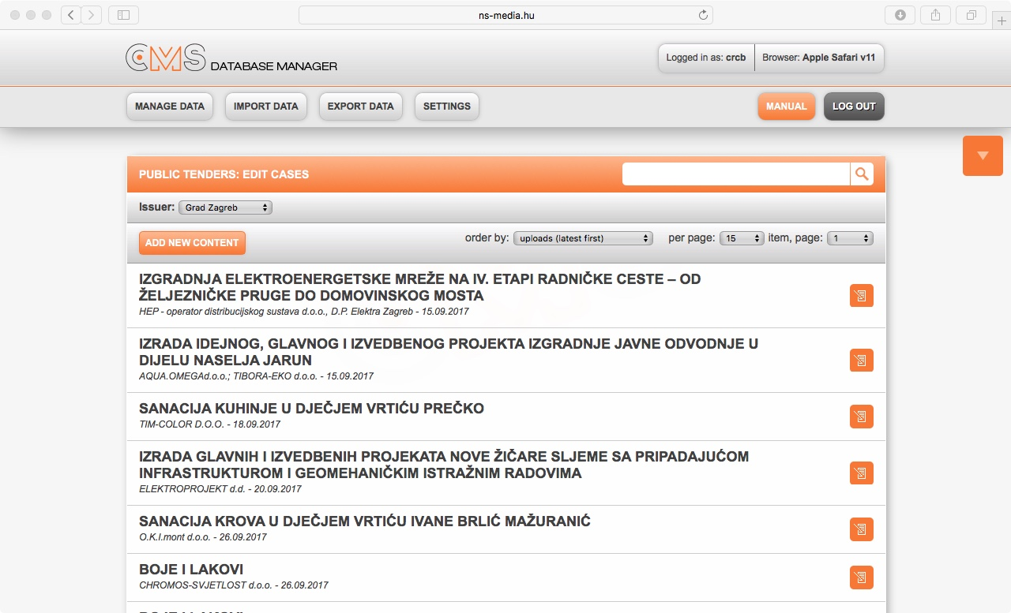
Database processing tool for the Croatian Public Procurement (DCPP)
motivations • mean results • lessons

Slide 6
MAIN RESULTS
motivations • results • lessons

Slide 7
motivations • results • lessons
1. The corruption risk of public procurement increased significantly. The share of tenders without competition increased from 25% to 34% between 2011 and 2016

Slide 8
Share of tenders without competition (SB=1) by year, 2011-16, %, N = 5,922
motivations • results • lessons

Slide 9
Share of tenders without competition (SB=1) in selected European capitals, 2006-15, N = 3,407,027
motivations • results • lessons

Slide 10
Share of tenders without competition (SB=1) in selected European capitals, 2006-15, N = 3,407,027
motivations • results • lessons

Slide 11
Share of tenders without competition (SB=1) in City of Zagreb and Zagreb Holding, 2011-16, 2011-16, %, N = 5,922
motivations • results • lessons

Slide 12
motivations • results • lessons
2. The intensity of competition (ICI) decreased considerably from 0.65 to 0.55 points during the period.
[0 ≤ ICI ≤ 1]

Slide 13
The average value of Indicator of Competitive Intensity (ICI) by year, 2011-16, N = 4,238
motivations • results • lessons

Slide 14
The average value of Indicator of Competitive Intensity (ICI) by year, 2011-16, N = 4,238
motivations • results • lessons

Slide 15
Intensity of Competition and Corruption Risk in selected European Capitals 2006-15, N = 3,407,027
motivations • results • lessons
Berlin
Vienna
Rome
Paris
Ljubljana
Budapest
Prague
Warsaw
Zagreb

Slide 16
motivations • results • lessons
3. The price distortion was high in 2013 and in 2015

Slide 17
The weight of price distortion: the squared error (SE) of contract prices of PPZ from the theoretical (Benford’s) distribution by year, 2011-16, N = 5,922
motivations • results • lessons

Slide 18
The weight of price distortion: the squared error (SE) of contract prices of PPZ from the theoretical (Benford’s) distribution by sectors, 2011-16, N = 5,922
motivations • results • lessons

Slide 19
motivations • results • lessons
4. 27% of the aggregate contract value was spent without competition. Between 2011
and 2016 the competition practically did not exist at more than the quarter of public money spent on public procurement. The highest value (43%) was in 2011 and the lowest one (21%) in 2015.

Slide 20
The share of money spent in PPZ without competition, %, 2011-16, N = 5,922
motivations • results • lessons

Slide 21
The sum of the value of PPZ without competition, in million HRK, 2011-16, N = 1,684
motivations • results • lessons

Slide 22
motivations • results • lessons
5. The median level of estimated direct social loss remained stable during the period and its value has moved between 31-34%

Slide 23
The median value of the ratio of estimated direct social loss in net contract value by year, %, 2011-16, N = 3,076
motivations • results • lessons

Slide 24
motivations • results • lessons
6. The results point to the existence of a positive link between corruption risks of public tenders and its importance in total sales of the company. If the role of the public procurement market is greater within the company's sales, the company typically won public tenders characterized by high corruption risks.
=> institutionalization of corruption (??)

Slide 25
The share of tender won the winner company as single bidder in total number of tender by the weight of total contract value of public tenders in total net turnover of the company %, 2011-15, N = 878
motivations • results • lessons

Slide 26
motivations • results • lessons
New Data from 2017.01-2017.09
Evolution before and after the local election of 2017
before: considerable increase of corruption risks
after: sudden drop

Slide 27
The share of tender without competition (SB=1) 2011.01. – 2017.09., quarterly data, N = 6,076
motivations • results • lessons

Slide 28
LESSONS
motivations • results • lessons

Slide 29
Lessons
motivations • results • lessons
Low intensity of competition
High corruption risks
High level of estimated direct social loss
Corruption towards institutionalization

Slide 30
Lessons
motivations • results • lessons
Need for a regular empirical analysis of the intensity of competition, corruption risks and direct social loss of public tenders.
This is the first step towards increasing of social welfare.

Slide 31
References
motivations • results • lessons
ACFE. 2016. Report to the Nations on Occupational Fraud and Abuse, 2016 Global Fraud Study. Association of Certified Fraud Examiners, USA: Austin, Texas.
Coviello, D., – Gagliarducci, S. 2010. Building Political Collusion: Evidence from Procurement Auctions. IZA DP No. 4939, Bonn: Institute for the Study of Labor (IZA). http://repec.iza.org/dp4939.pdf
Chvalkovska, J., Fazekas, M., Skuhrovec, J., Tóth, I. J., King L. P. 2013. Are EU funds a Corruption Risk? The Impact of EU Funds on Grand Corruption in Central and Eastern Europe. In: Pippidi-Mungiu, A. Controlling Corrution in Europe. The Anticorruption Report 2. Oplanden, Berlin & Toronto: Barbara Budrich Publishers. pp. 68-89.
Czibik, Á., Fazekas, M., Tóth, B., Tóth I. J. 2014. Toolkit for detecting collusive bidding in public procurement. With examples from Hungary. Working Paper Series: CRCB-WP/2014:02. CRCB, Budapest, 2014. http://bit.ly/2aDRYM7
CRCB. 2016. Competitive Intensity and Corruption Risks in the Hungarian Public Procurement 2009-2015. Main Findings & Descriptive Statistics. Budapest, CRCB. http://bit.ly/1TBpQDa
Durtschi, C. - Hillison, W.- Pacini, C. 2004. “The Effective Use of Benford's Law to Assist in. Detecting Fraud in Accounting Data”, Journal of Forensic Accounting, Vol V. pp. 17-34, http://bit.ly/1QSUOER.
Drake, P. D. – Nigrini, M. J. 2000. “Computer assisted analytical procedures using Benford’s law”, Journal of Accounting Education, Vol. 18. no. 2. pp. 127-146;
Fazekas, M., Tóth, I.J., King. L. P. 2013a. Anatomy of grand corruption: A composite corruption risk index based on objective data. Budapest, CRCB. http://bit.ly/1Yc7zQL
Fazekas, M., King, L. P., Tóth, I. J. 2013b. Hidden Depths. The Case of Hungary. In: Pippidi-Mungiu, A. Controlling Corrution in Europe. The Anticorruption Report 1. Oplanden, Berlin & Toronto: Barbara Budrich Publishers. pp74-82.
Fazekas, M., Tóth, I. J., King, L. P. 2016. “An Objective Corruption Risk Index Using Public Procurement Data”. European Journal on Criminal Policy and Research, First Online: 25 April 2016 doi: 10.1007/s10610-016-9308-z.
Fazekas, M., and Tóth, I. J. 2016. “From Corruption to State Capture. A New Analytical Framework with Empirical Applications from Hungary”. Political Research Quarterly, June 2016, vol. 69. no. 2. pp. 320-334, doi: 10.1177/1065912916639137.
Fazekas, M. - Tóth, I. J. 2017. Corruption in EU Funds? Europe-wide evidence of the corruption effect of EU-funded public contracting. In: Bachler, J., Berkowitz, P., Hardy S., Muravska, T.: EU Cohesion Policy. Reassessing Performance and Direction, Routledge, London & New York., pp. 186-205.
Garrido, Melissa M, Amy S. Kelley, Julia Paris, Katherine Roza, Diane E. Meier, R. Sean Morrison. 2014. Methods for Constructing and Assessing Propensity Scores. Health Services Research, 49 (5): 1701–20. doi:10.1111/1475-6773.12182
IEER. 2016. Integrity and corruption risks within the Hungarian corporate sector. Budapest: Institute for Economic and Enterprise Research. http://bit.ly/2jzzdZj

Slide 32
References
motivations • results • lessons
King, G., Nielsen, R. 2016. Why Propensity Scores Should Not Be Used for Matching. http://bit.ly/2iWZSUd
Kossovsky, A. E. 2015. Benford’s Law. Theory, the General Law of Relative Quantities, and Forensic Fraud Detection Applications. Hackensack, New Jersey, USA: World Scientific
Lambsdorff, J. G. 2007. The Institutional Economics of Corruption and Reform. Theory, Evidences and Policy. Cambridge, UK: Cambridge University Press
Lechner, Michael. 2002. Program Heterogeneity and Propensity Score Matching: An Application to the Evaluation of Active Labour Market Policies. The Review of Economics and Statistics (84): 205-220. http://bit.ly/2j6kZPi
Miller, S. J. (ed.). 2015. Benford’s Law: Theory and Applications. Princeton, New Jersey, USA: Princeton University Press
Kevin M. Murphy, Andrei Shleifer and Robert W. Vishny. 1993. “Why Is Rent-Seeking So Costly to Growth?” The American Economic Review Vol. 83, No. 2, Papers and Proceedings of the Hundred and Fifth Annual Meeting of the American Economic Association (May, 1993), pp. 409-414. http://bit.ly/2ahOOJg
Nigrini, M. J. 1996. “A taxpayer compliance application of Benford’s law”. Journal of the American Taxation Association. Vol. 18. no 1. pp. 72–91.
Nigrini, M. J. (ed.). 2012. Benford's Law. Applications for Forensic Accounting, Auditing, and Fraud Detection. Hoboken, New Jersey, USA: John Wiley & Sons
Spann, Delena D. 2013. Fraud Analytics: Strategies and Methods for Detection and Prevention, Hoboken. New Jersey, USA: John Wiley & Sons
Szanto, Z., Tóth, I. J., Varga, S. 2012. The social and institutional structure of corruption: some typical network configurations of corruption transactions in Hungary, In: Vedres, B., Scotti, M. (eds.): Network sin Social Policy Problems. Cambridge, UK: Cambridge University Press Cambridge, UK: Cambridge University Press.
Rose-Ackerman, S. (ed.). 2006. International Handbook on the Economics of Corruption, Cheltenham, UK: Edward Elgar.
Rose-Ackerman, S. – Soreide, T. 2011. International Handbook on the Economics of Corruption. Volume Two. Cheltenham, UK: Edward Elgar.
Rosenbaum, Paul R., Donald B. Rubin. 1983. The Central Role of the Propensity Score in Observational Studies for Causal Effects. Biometrika. 70 (1): 41–55. doi:10.1093/biomet/70.1.41
Tóth, I. J., Hajdu, M. 2016a. Competitive Intensity and Corruption Risks in the Hungarian Public Procurement 2009-2015. Paper presented at the University of Cambridge, „Data for Policy” Conference, http://bit.ly/2b8p8kW
Toth, I. J., Hajdu, M. 2016b. Korrupciós kockázatok, átláthatóság, közbeszerzések. Magyar közbeszerzések 2009–2015 közötti adatainak elemzése. In: Kolosi, T.- Tóth, I. Gy. (szerk.): Társadalmi Riport. Tárki, Budapest. 33-53. old. [Corruption risks, transparency, public procurement. Analysis of Hungarian Public Procurement in the period of 2009 and 2015. In: Kolosi, T. – Tóth, I. Gy. (eds): Social Report – 2016. Budapest: Tárki, pp. 33 -53.] http://bit.ly/2dA9XlI
Varian, H. R.1972.: “Benford’s law”, The American Statistician, 26. Vol. no.3. pp. 65–66.

Slide 33
Thank you for your attention!
Corruption Research Center Budapest
www.crcb.eu

